Slide 1
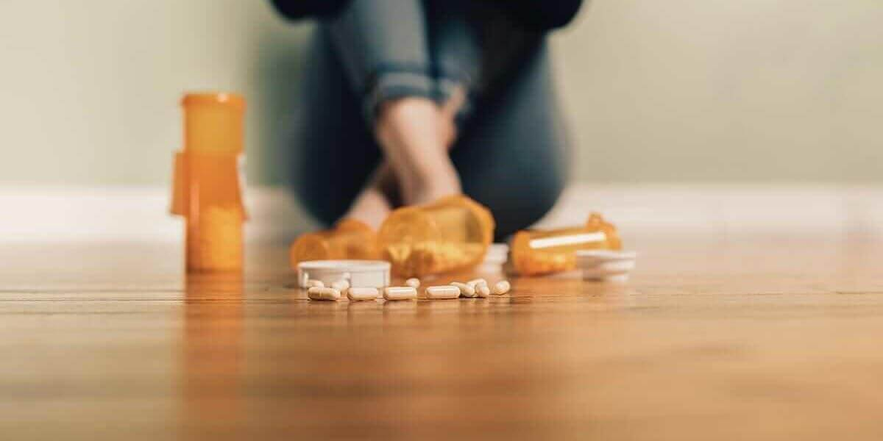
Prescriptions & overdose
Christian Alsider

Slide 2

Introduction
In the past addictions and overdoses were seen as “social class” problems.
The opiate crisis changed that. The dope dealer moved from the trap house to the doctor's office. Suddenly overdoses were no longer the panda eye junkie from a after school PSA, they have high functioning members of society who no one suspects has an addiction.
Was it the change in the prescribing habits of our providers?

Slide 3
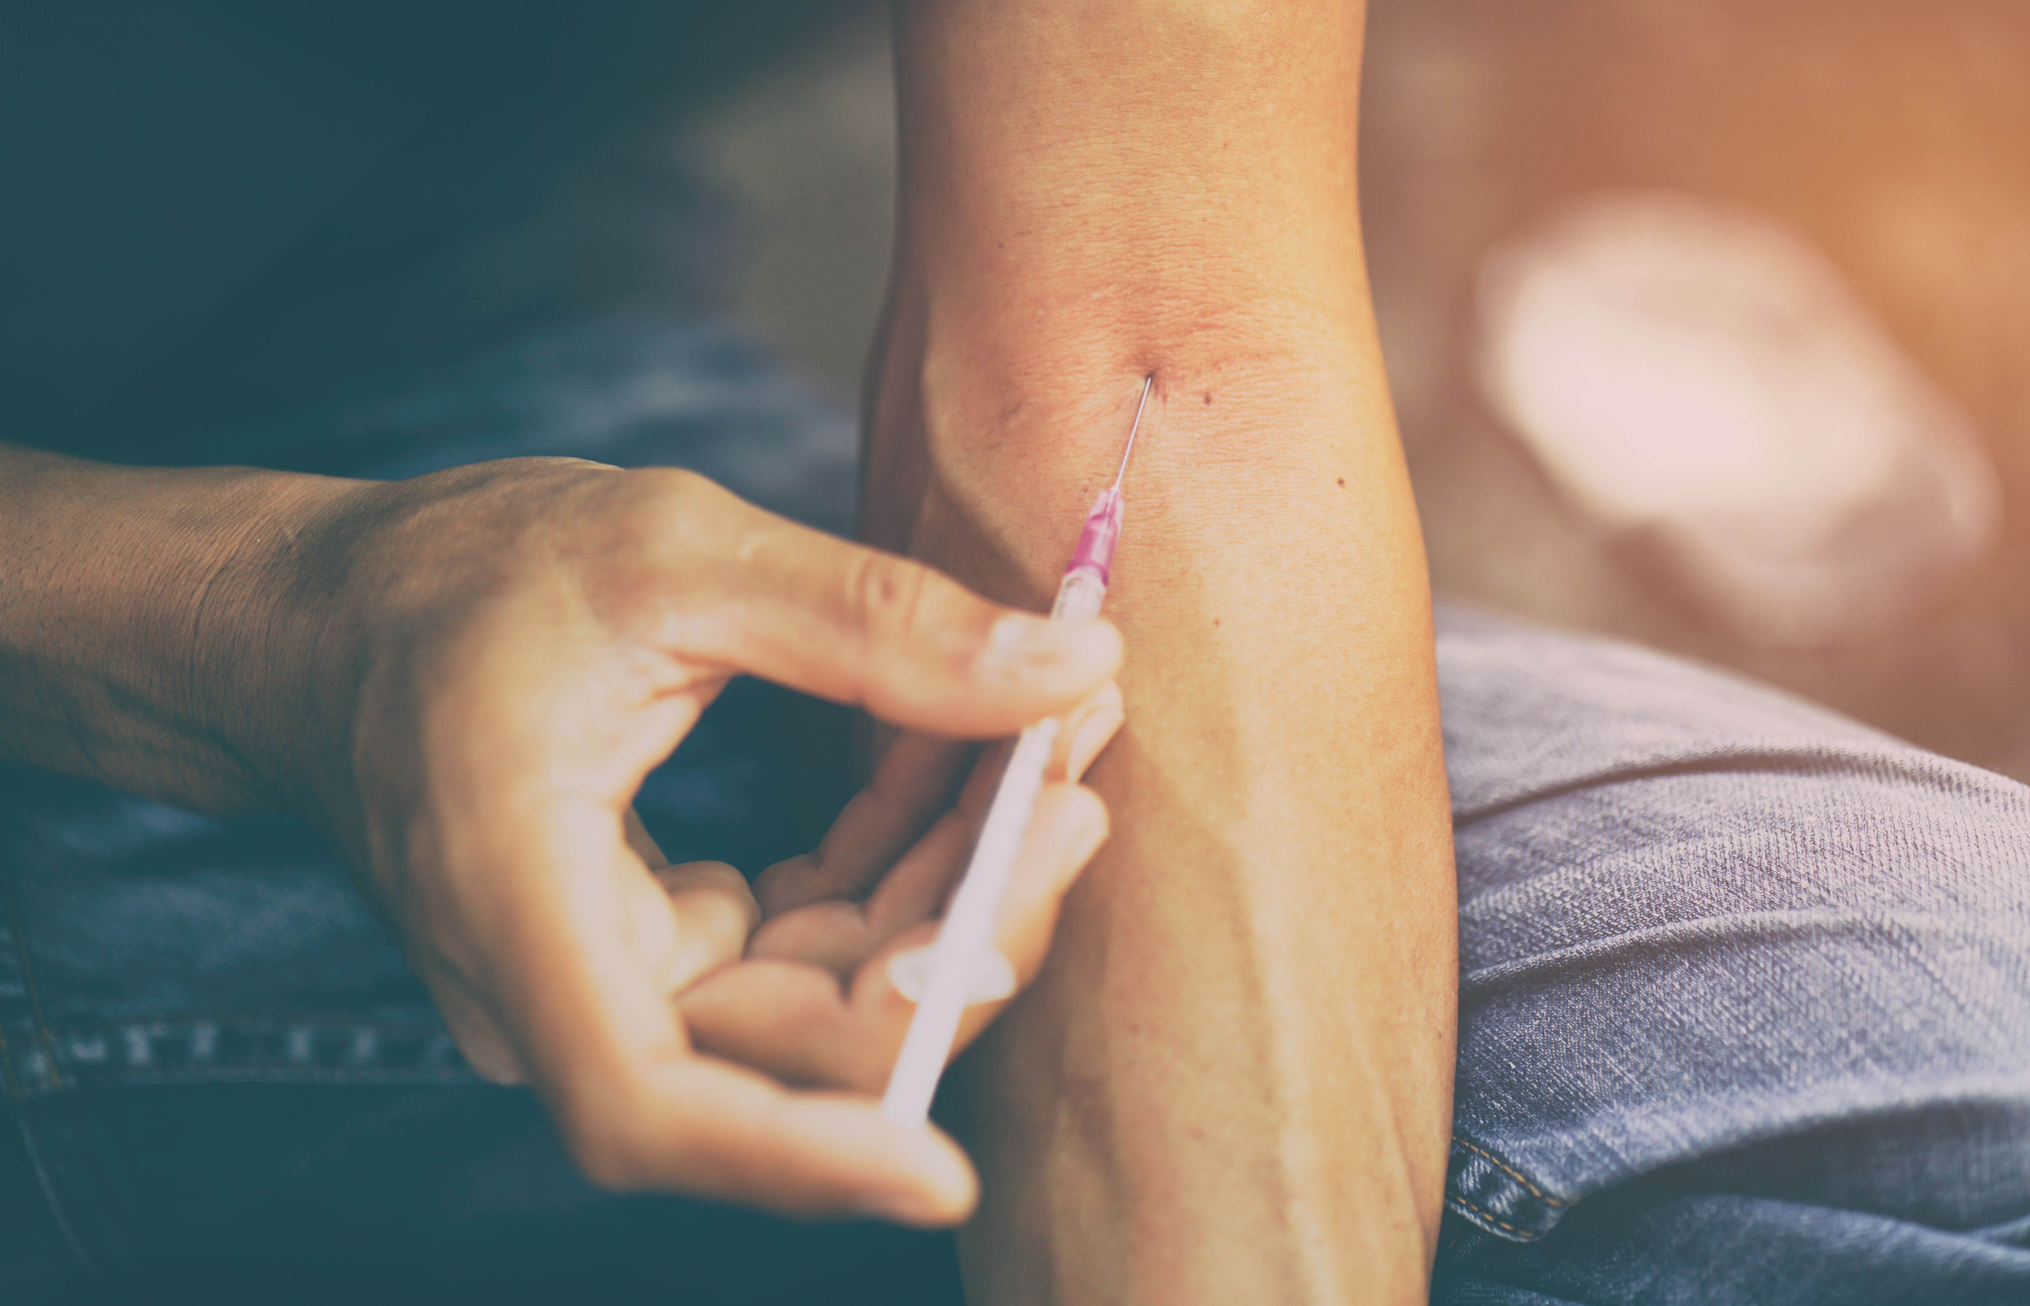
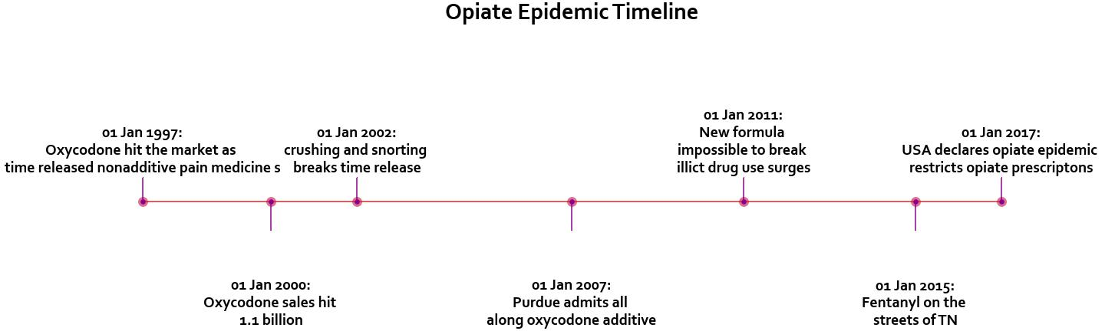
How did we get here?

Slide 4
1997 Oxycod
2000
2007
2002
2011
2015
2017

Slide 5
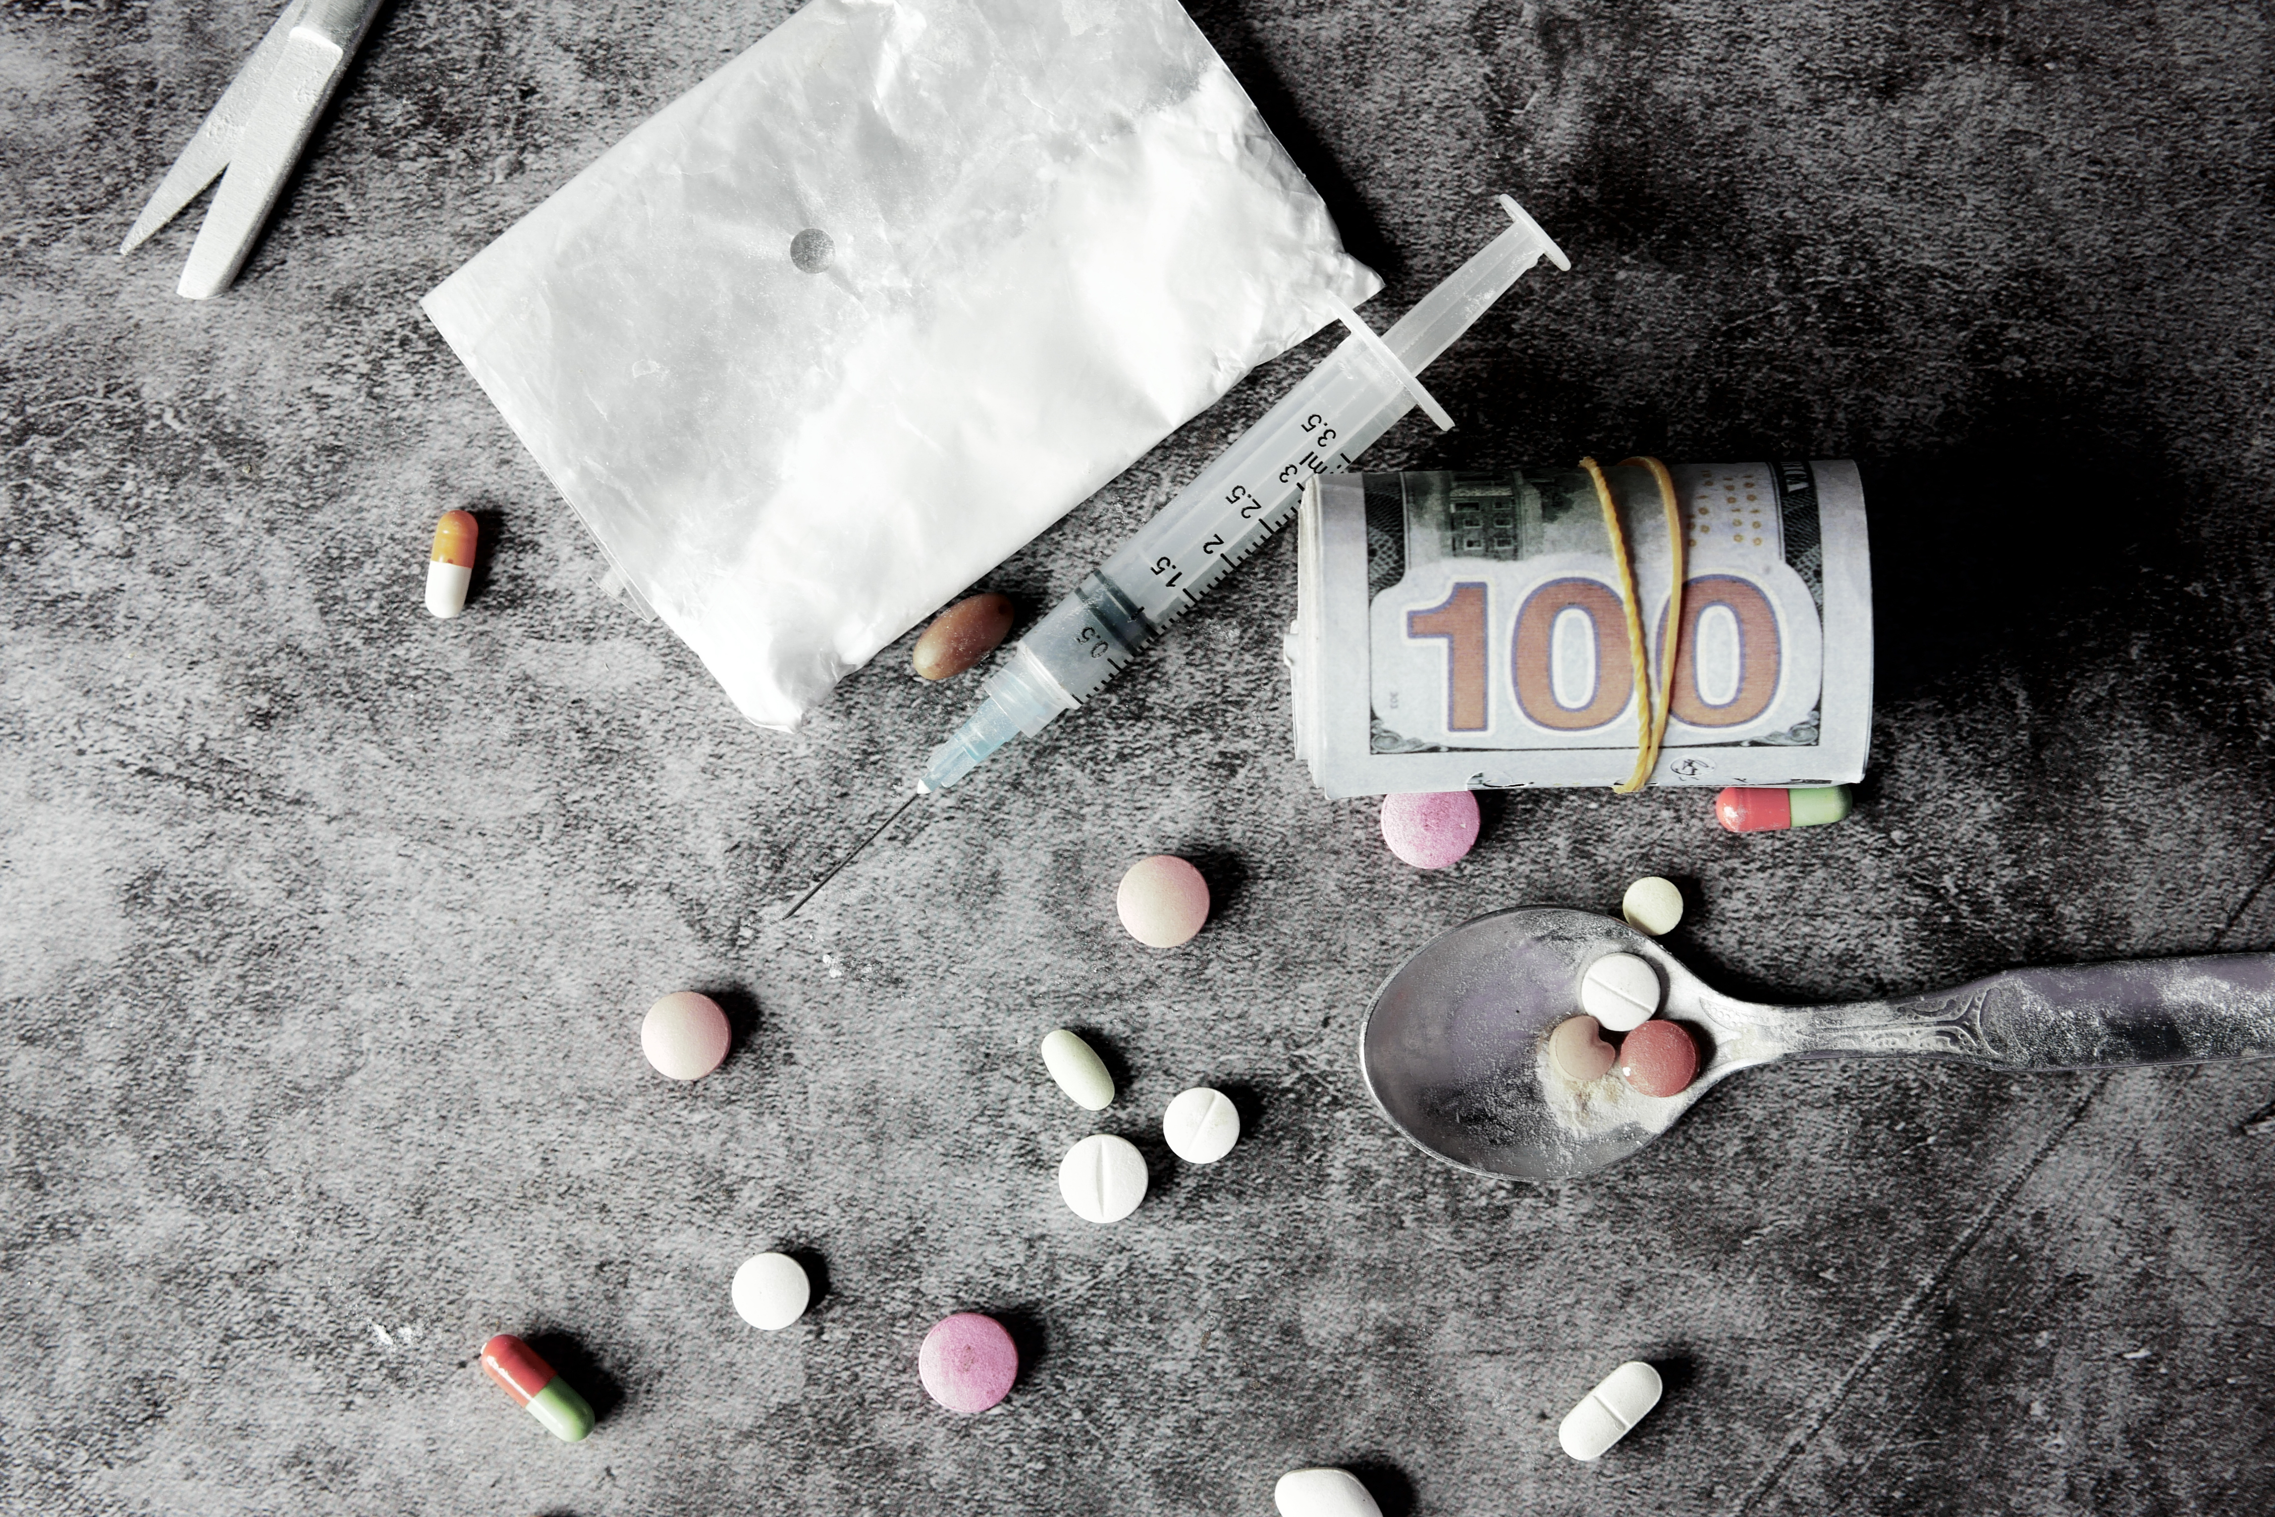
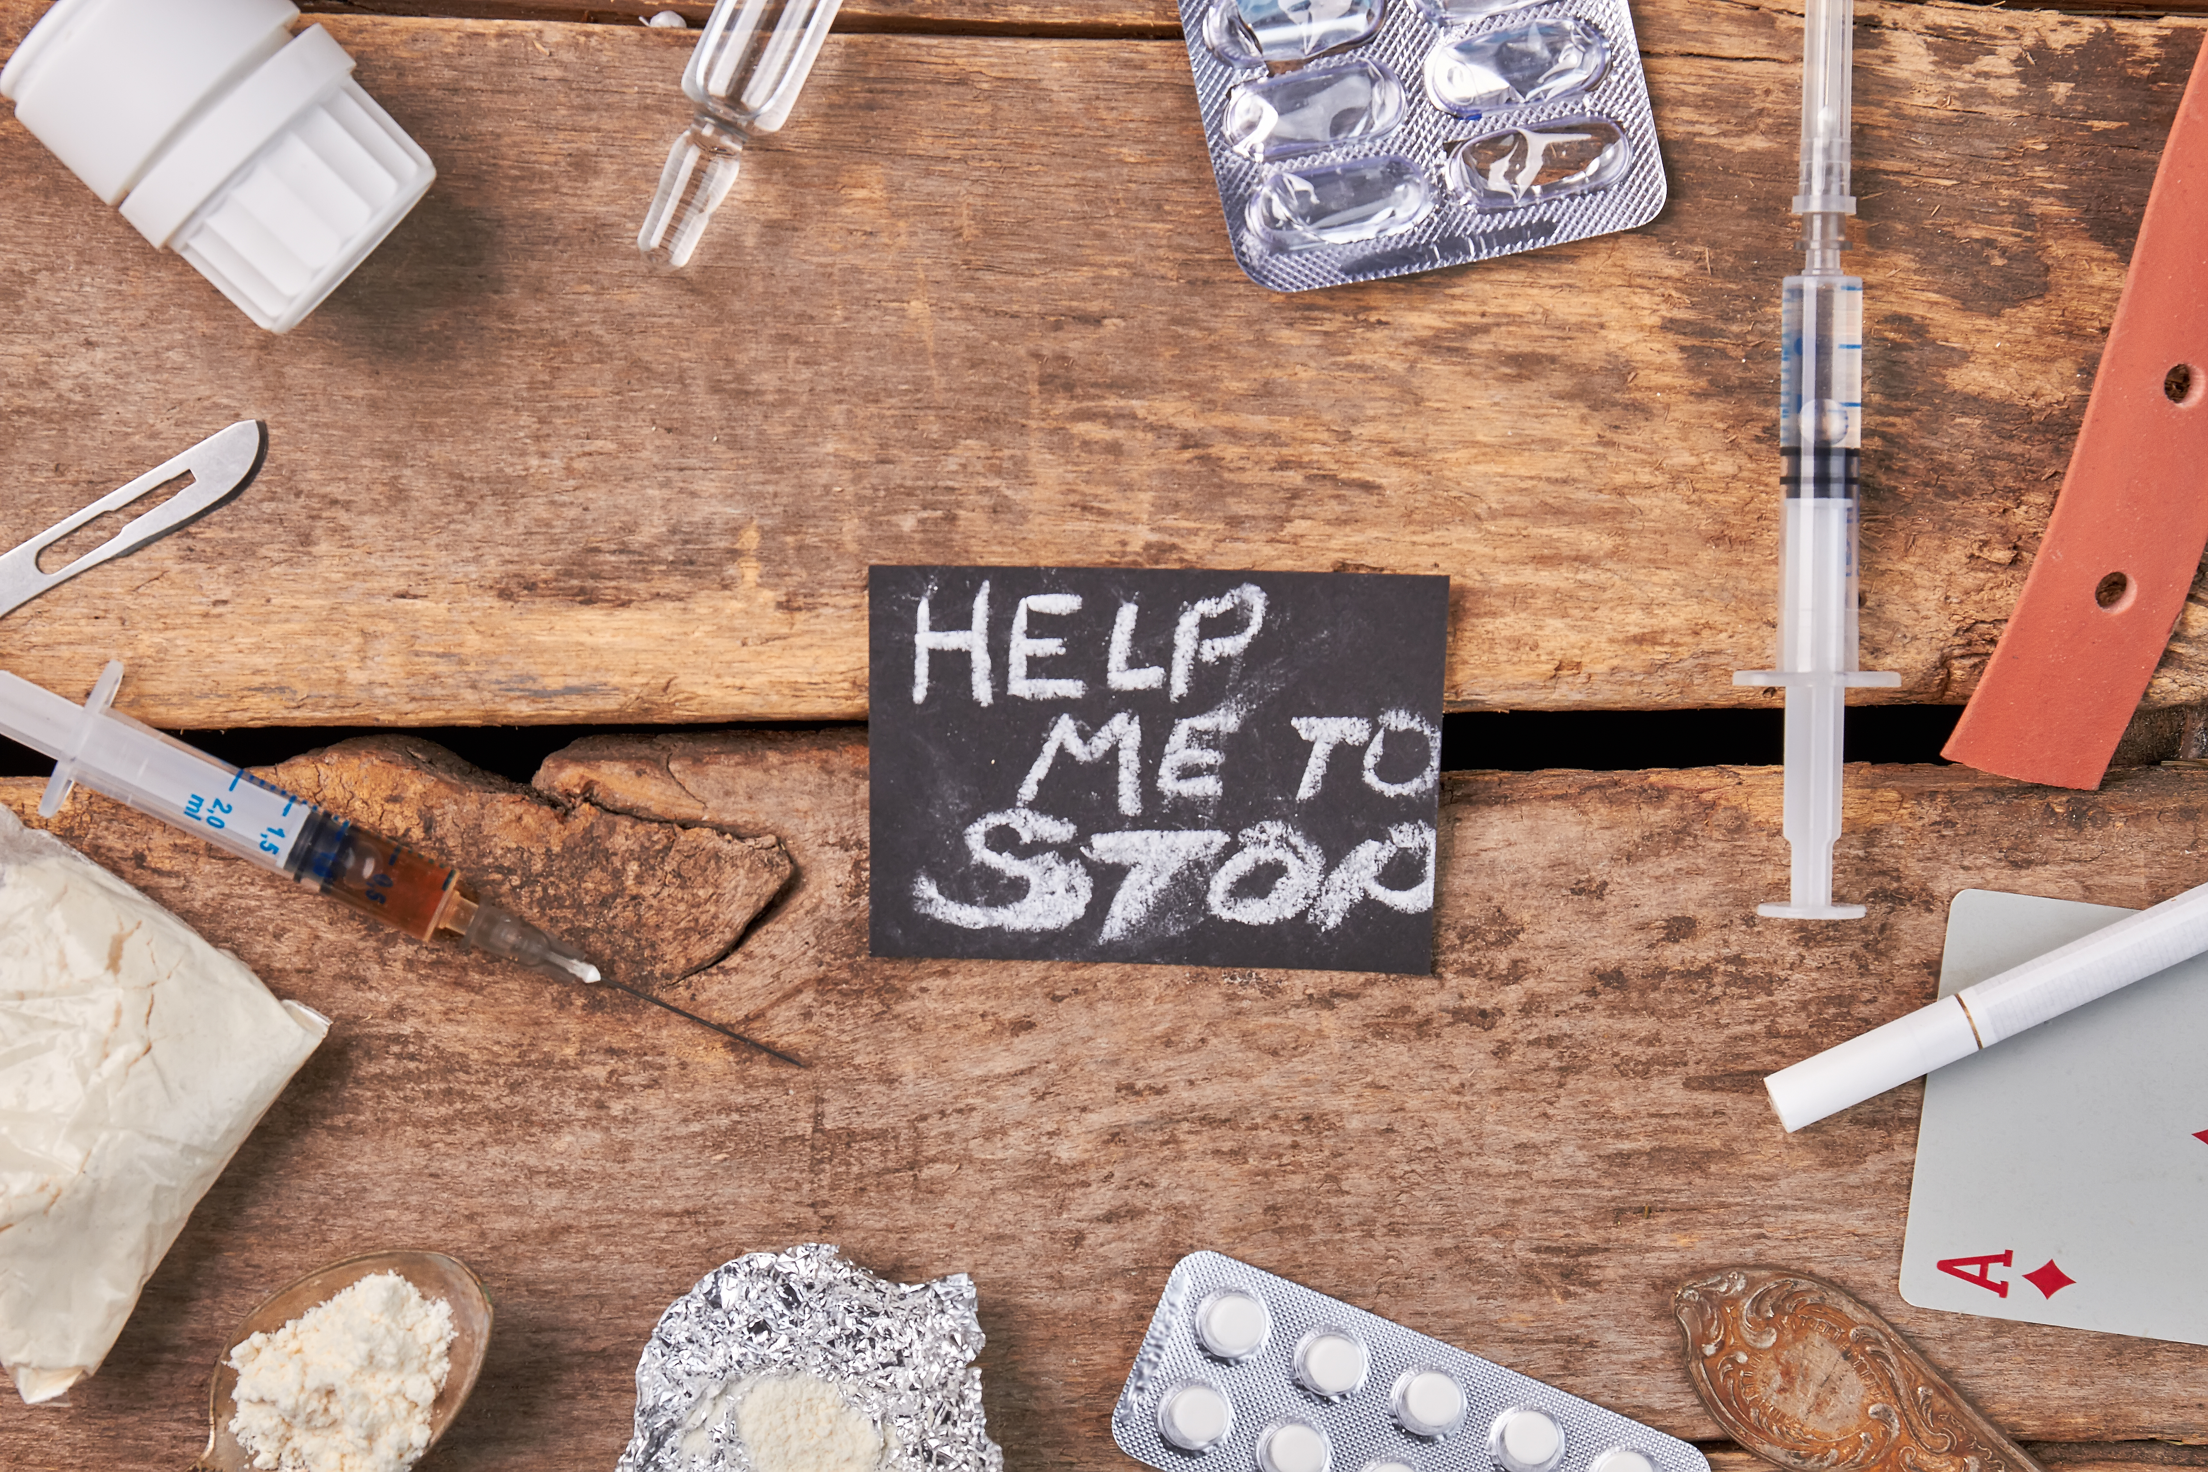
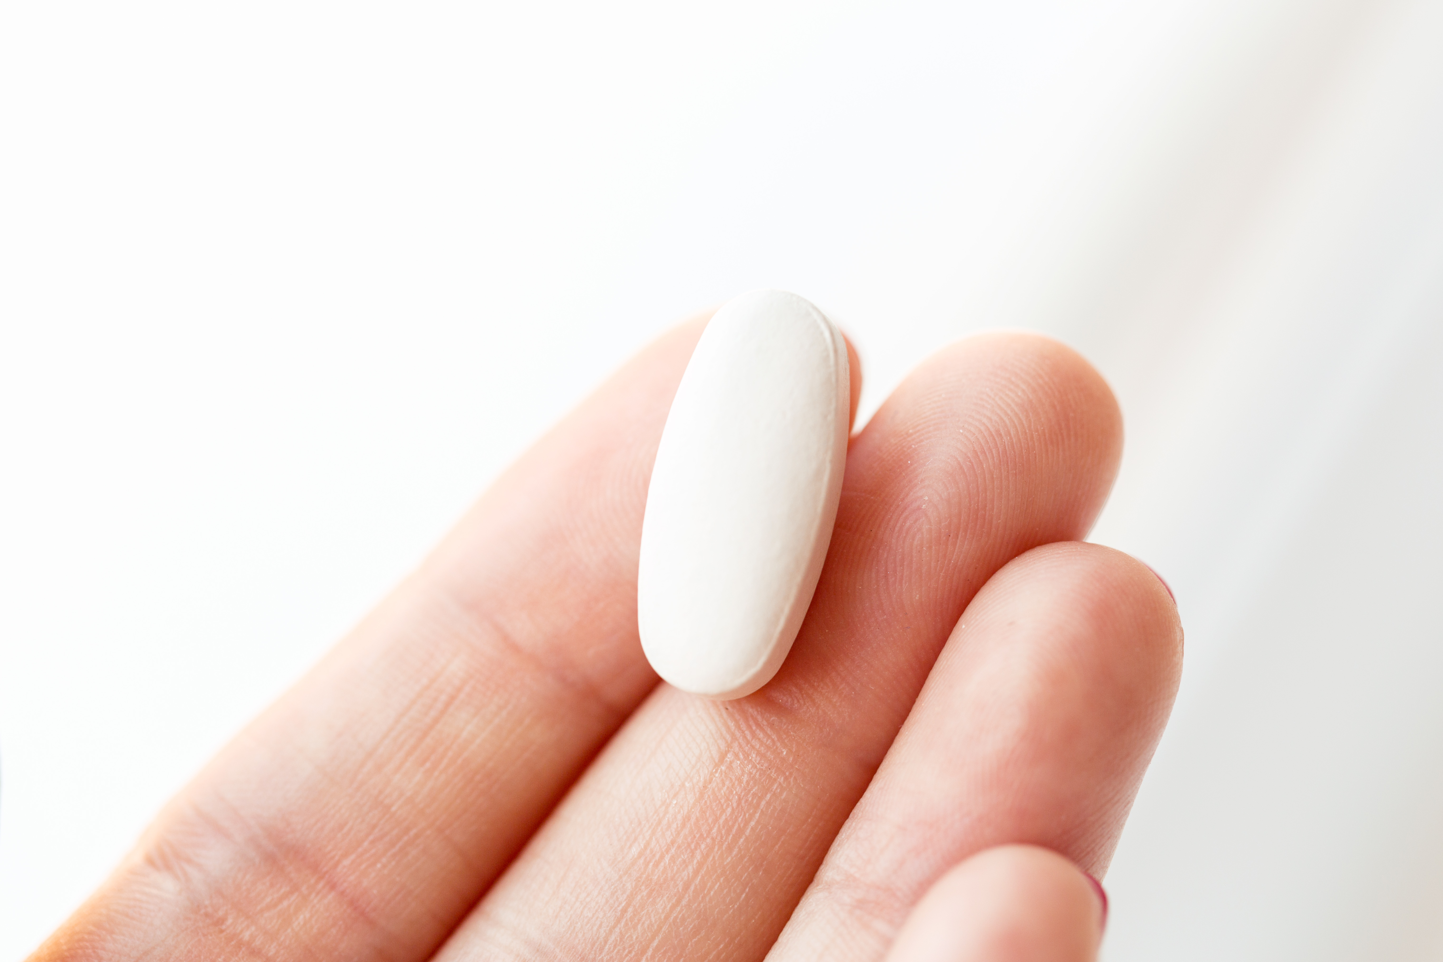
Prescribing trends

Slide 6
Opiate prescription's 2006-2020

Slide 7
Prescriptions USA vs TN

Slide 8
Top Prescribed Drugs By Year

Slide 9
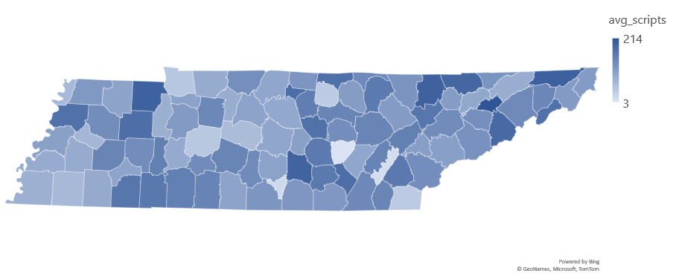
Prescriptions per 100 by county

Slide 10
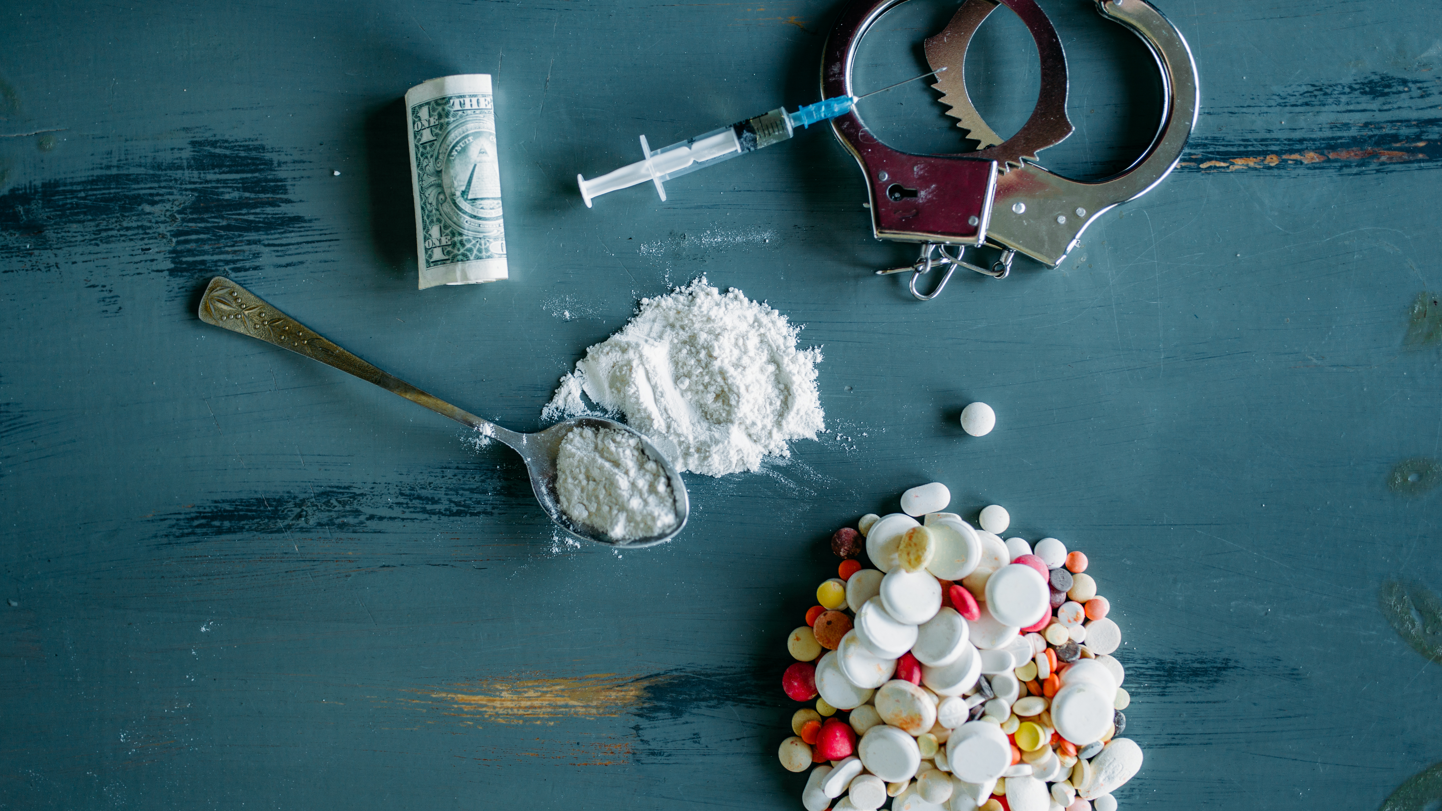
Fatal overdoses

Slide 11
Fatal overdoses 2013-2020

Slide 12
Fatal overdoses USA 1980-2020

Slide 13
Fatal OD BY Drug and Year

Slide 14
Fatal overdose by county avg
Tennessee above average in the USA

Slide 15

The way to get started is to quit talking and begin doing.
Walt Disney
Non Fatal Overdoses
Fatal overdoses

Slide 16
Non-Fatal overdoses 2013-2020

Slide 17
Non-Fatal overdoses 2013-2020

Slide 18
Additional content
Subtitle
Subtitle
Subtitle
Add text, images, art, and videos.
Add transitions, animations, and motion.
Save to OneDrive, to get to your presentations from your computer, tablet, or phone.
Open the Design Ideas pane for instant slide makeovers.
When we have design ideas, we’ll show them to you right there.
This PowerPoint theme uses its own unique set of colors, fonts, and effects to create the overall look and feel of these slides.
PowerPoint has tons of themes to give your presentation just the right personality.

Slide 19


Thank you
Christian Alsider
christianlalsider@gmail.com
www.linkedin.com/in/christianalsider

